Slide 1


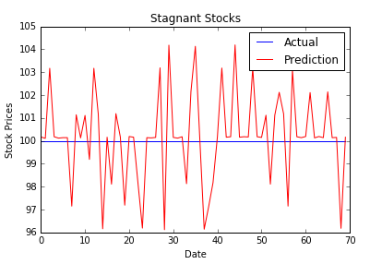
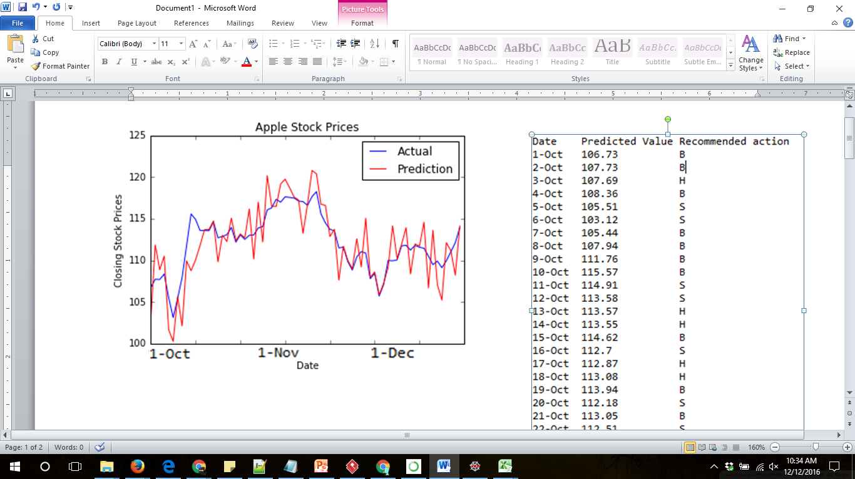
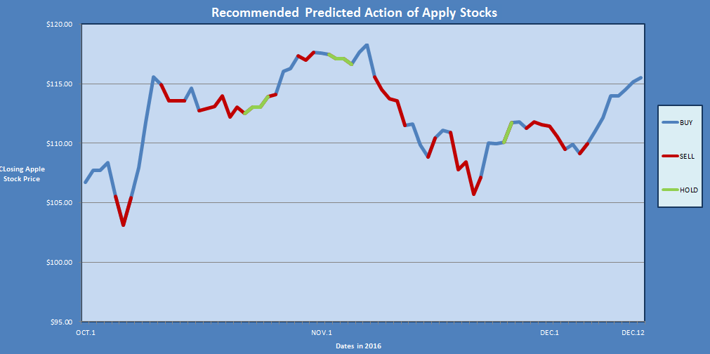
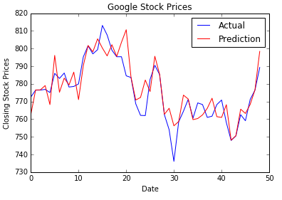
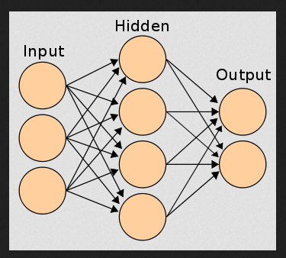
Stock Prediction – A Neural Network Approach
Jason Nelson
CS5600 Fall 2016
Abstract
Results
Looking into how the system behaves the Ai is tested (same year time frames) against a stock price that unchanging. The system results was interesting to see that it was unable to see that the stock was stagnant. Deviation of about $1.30
The purpose of this project is to develop an artificial intelligence system that is capable predicating stock prices. The AI implements Technical Indicators input through a Neural Network.
Once trained of a 10 year data set (Open, close, high, low, and volume) and executed with 20 stock technical indicators over the past 2 months the results found show that the best run with the predictor was able to estimate prices with the standard deviation of $3.70 for Apples stock prices.
Problem Description
While stock trading is common, making money through such trading with an AI is not. Such successful trading requires critical judgement and analysis. We work to produce results that will predict correct stock prices resulting in a financial gain.
Methods
The system works by pulling information (open, close, high, low, volume) from a csv file, puts that information through a puts it through the neural network. Once it is trained by data set, it will produce a prediction for the following day. The prediction will be output the predicted stock price for the following day, with the recommended action in the form of B (Buy), S (Sell), or H (Hold). The algorithm is ran for each “new” day on the past data, putting in all the technical indicators through the neural network.
Some Technical Indicators Used
Results of Buy, Sell, Graph outputs, set to actual stock prices.
Running the algorithm trained with 10 year data set, with same indicators and 2 month time period. The results show that the deviation of $16.30 with Googles stock prices
Moving Average
Exponential Moving Average
Rate of Change
Average True Range
Bollinger Bands
Pivot Points, Supports and Resistances
Stochastic oscillator
Average Directional
Movement Index
Mass Index
Vortex Indicator:
KST Oscillator
Relative Strength Index
True Strength Index
Accumulation/Distribution
Chaikin Oscillator
Money Flow Index and Ratio
On-balance Volume
Force Index
Ease of Movement
Coppock Curve
Keltner Channel
Ultimate Oscillator
Donchian Channel
Standard Deviation
Conclusion
Though the predictions where close to the actual stock movement, the overall conclusion is the current system is unable to successfully trade on the market. It doesn’t lose drastically but slowly over time. It did make a few successful trades but that would not compensate for the other bad trades. Future work will involve working with the larger data set, different stocks, machine learning with news feeds, and implementing a trader.
Neural Networks work with groups of nodes, with given inputs ( about 20 Technical Indicators) sent through a layer of hidden nodes with the resulting outputs. We are using inputs from each
Example Neural Network*
References
http://stockcharts.com/school/doku.php?id=chart_school:technical_indicators
https://www.quora.com/Why-is-Machine-Learning-neural-networks-and-other-AI-approaches-for-instance-not-more-widely-used-in-stock-market-prediction
"The Rise of the Artificially Intelligent Hedge Fund." Wired. Conde Nast, n.d. Web.

